Slide 1


Dynamic Forms
Survey, Inspection and General Purpose
M.P. State Electronics Development Corporation Ltd.
A Government of MP Undertaking
https://geoportal.mp.gov.in/

Slide 2

About Parakh
Developed by Madhya Pradesh State Electronics Development Corporation.
Parakh is a solution that equip the departments to create custom forms for Surveys, Inspection, Data Collection, and General purposes.
Parakh Survey and Inspection forms are enabled with workflow:
Department’s Field Officer first conduct a survey or Inspection.
The Nodal Officer/Reporting Officer then verify (Approve or Reject) the conducted surveys or inspections.
General Purpose forms are data collection forms which requires no workflow.
Parakh also enables “Citizens” and “Agencies” to fill out the forms, which are initiated by the respective department.

Slide 3

What makes Parakh unique ?
Custom Forms: GIS enabled multi purpose forms can be created.
Usage could be for Survey, Inspection, Data Collection, Questionnaire or General Purpose.
Ease of Use: Department’s admin Or business user can create their own custom forms. No dependencies on code/development/build.
Workflow: Facilitates admin to “initiate & assign”, to conduct a survey, inspection, or to fill a general form.
Reach: Enables “Citizens” and “Agencies” to also fill out the forms,
Solution: Versatile solution designed for both Mobile and Web.
Quick to Launch: Create a form using UI interface(web) and launch it on Mobile.

Slide 4
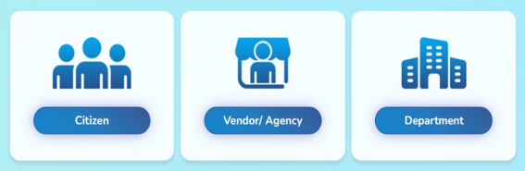





Actors in Parakh
Inspection & Survey Workflow (Department Users)
Nodal Officer assign work to field officer via web portal
The Field Officer sees the assigned work with all the information of the site under PARAKH application.
Field officer input and capture GIS-based Inspection/Survey details through the mobile application.
Following the submission of the Inspection/Survey by the field officer, the nodal officer undertakes a review and verifies the submitted data.

Slide 5

Salient features
Web and Mobile Application for Department, Agency and Citizen users.
Self-registration via mobile app for inspection officers.
Reporting Officer / Nodal Officer will validate the authenticity of requested registration.
Enable Citizens, Agencies and Inspection officers to input and capture Inspection/Survey/General Forms details through the mobile application.
Incorporate geo-location features to capture the live location.
Option to attach photos, video documents, or other relevant files as evidence or additional information to support inspection findings.
Nodal and reporting officer allocated/assigned inspection Site to Inspection officer for Inspection.
Web portal for the Supervisor/Nodal Officer to visualize and take necessary action (Approve or Reject) the data submitted by the Inspector.
Enable Admin to create and edit the Forms.
Enable Admin to add Inspection Sites.

Slide 6

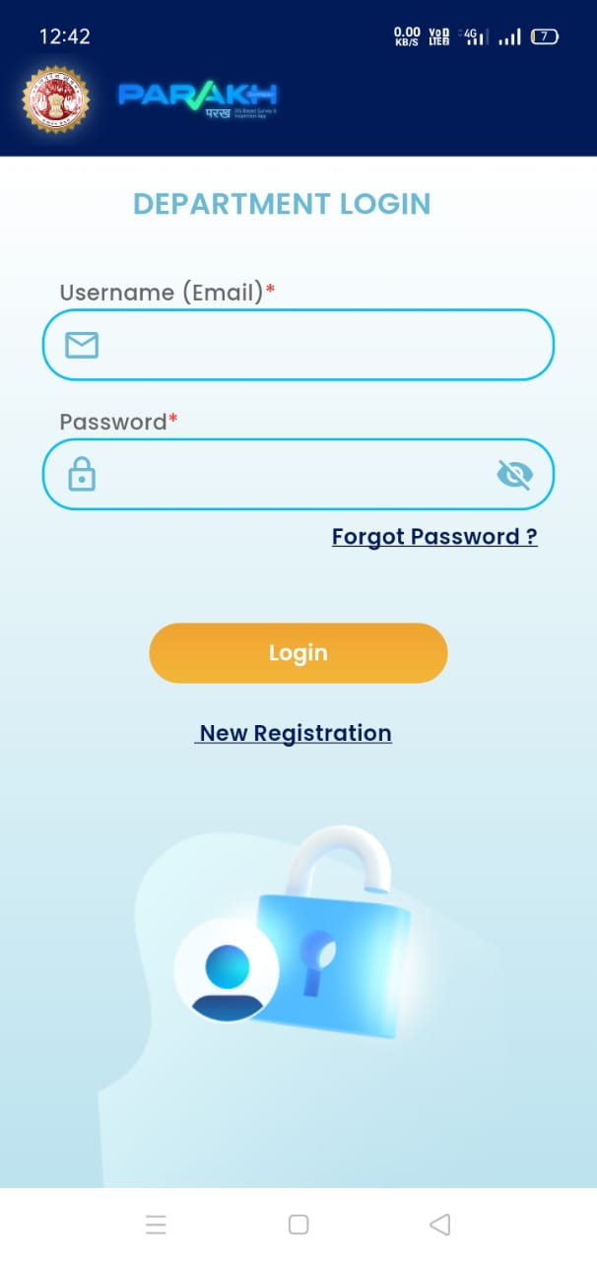
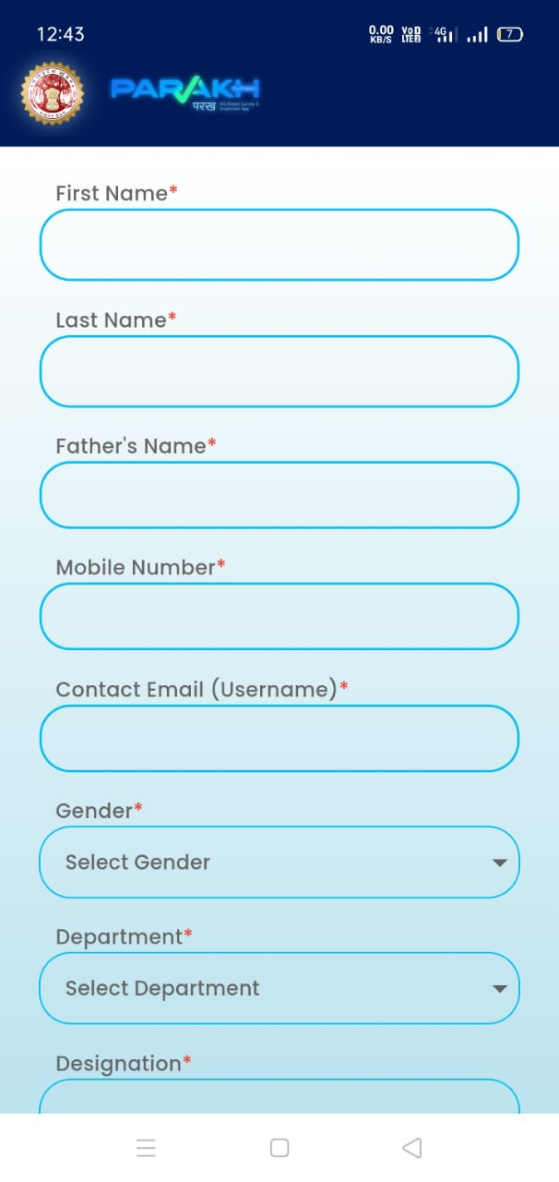
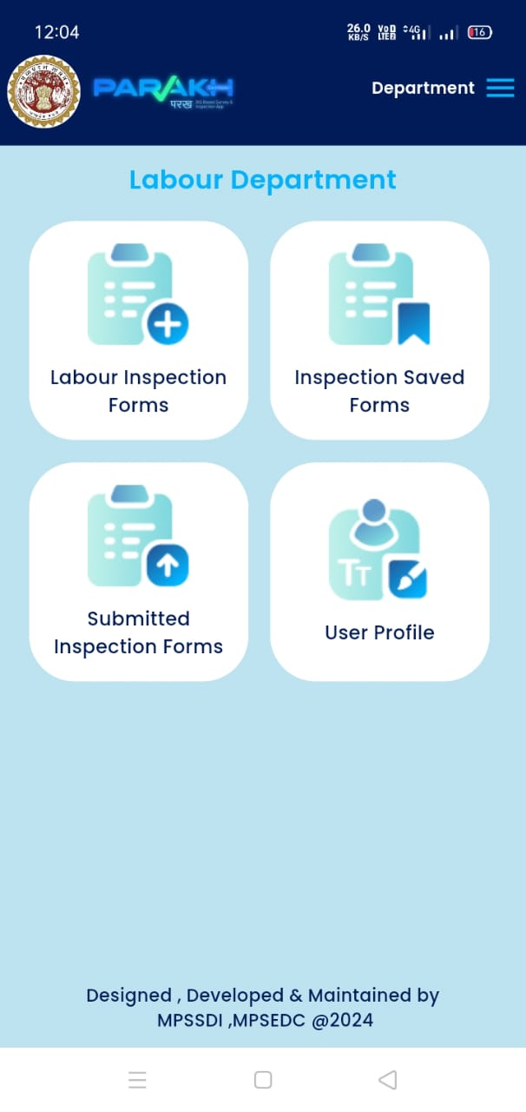
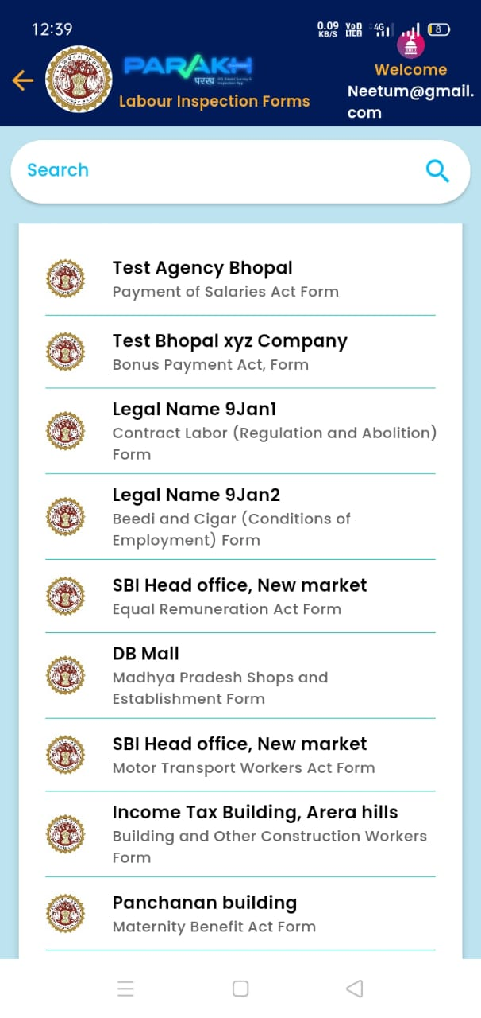
Mobile Inspection Application Flow
Login Screen
Field Officer Registration Page
Field Officer Login: Home Page
List of Inspections to be conducted

Slide 7
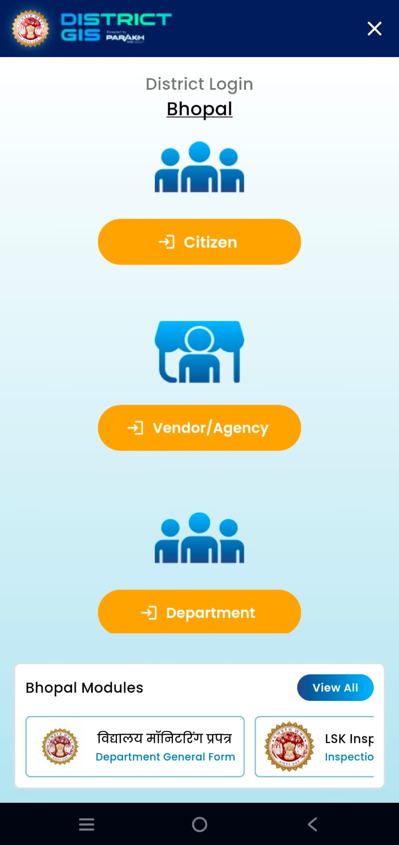
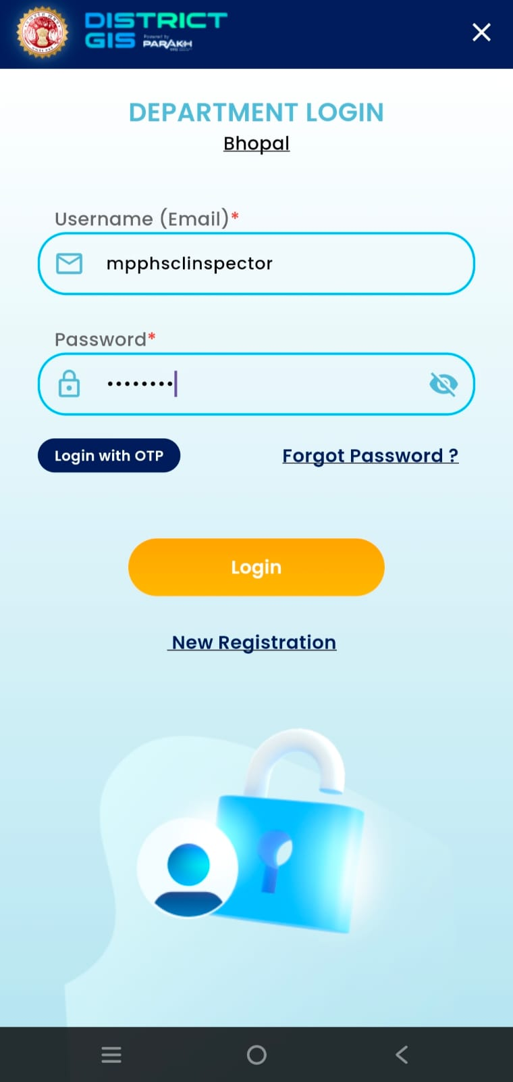
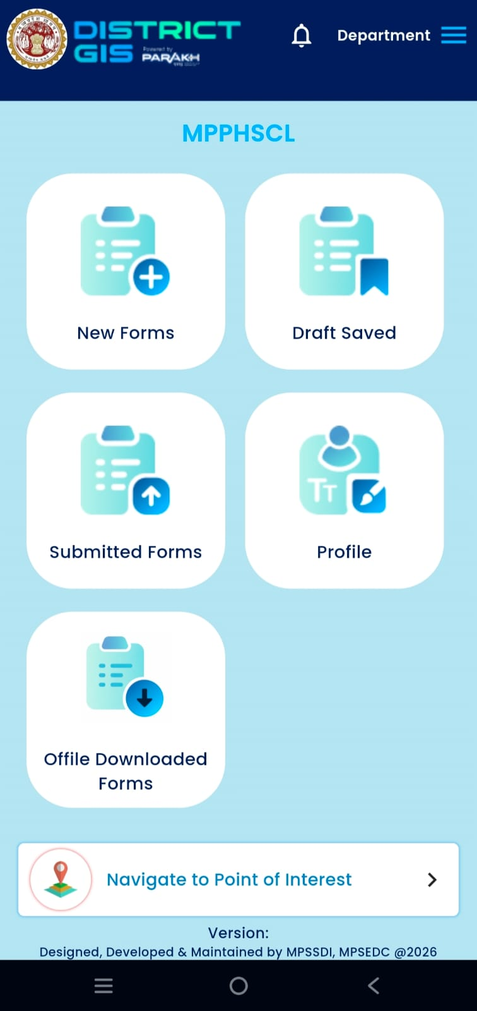
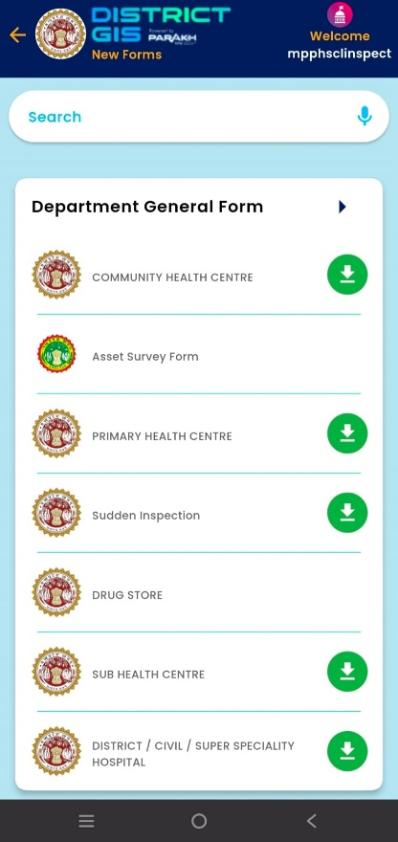
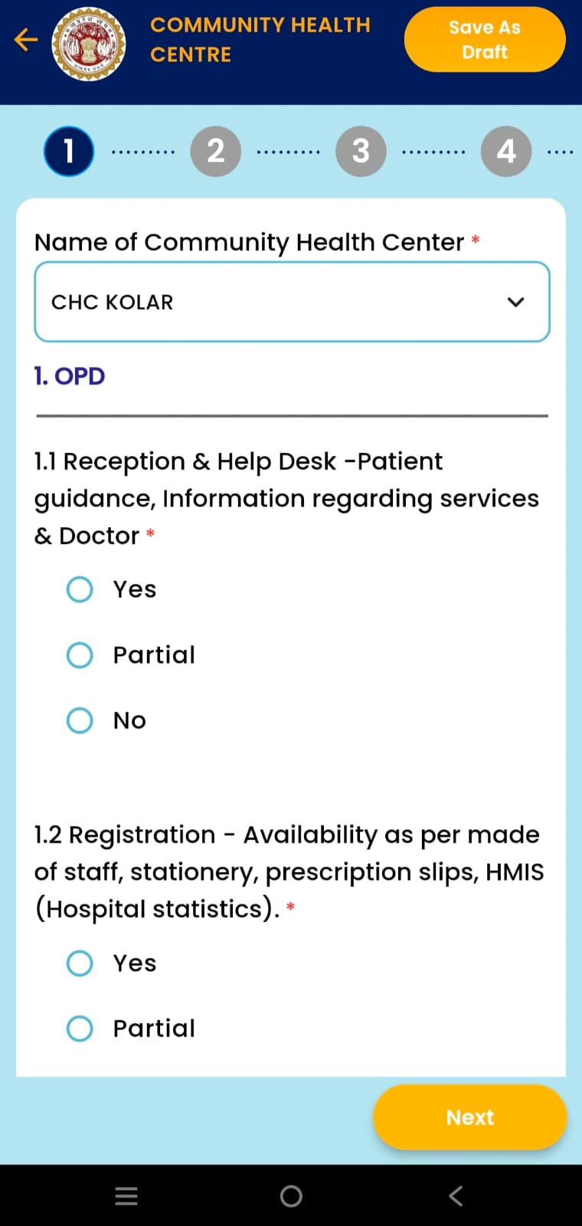
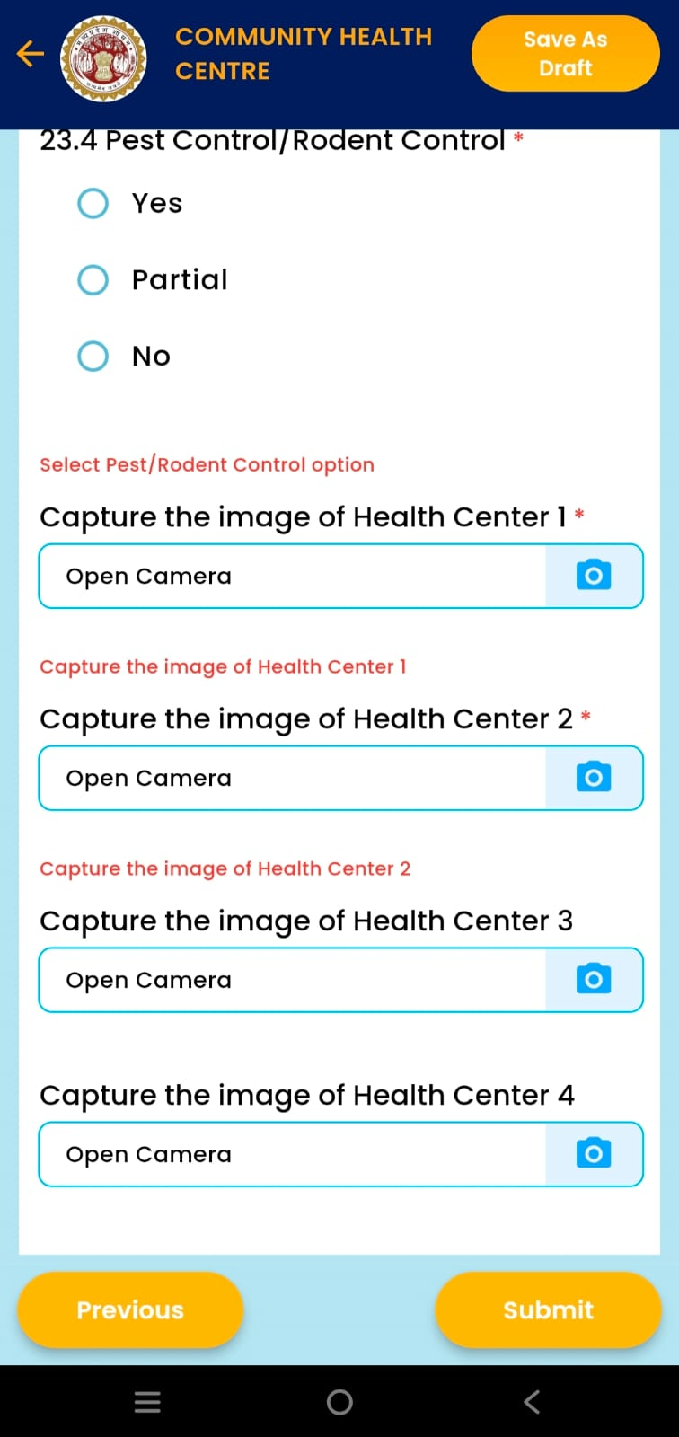
06 | Mobile App — District GIS Parakh
📱 Mobile App Steps
1
2
3
4
5

Slide 8
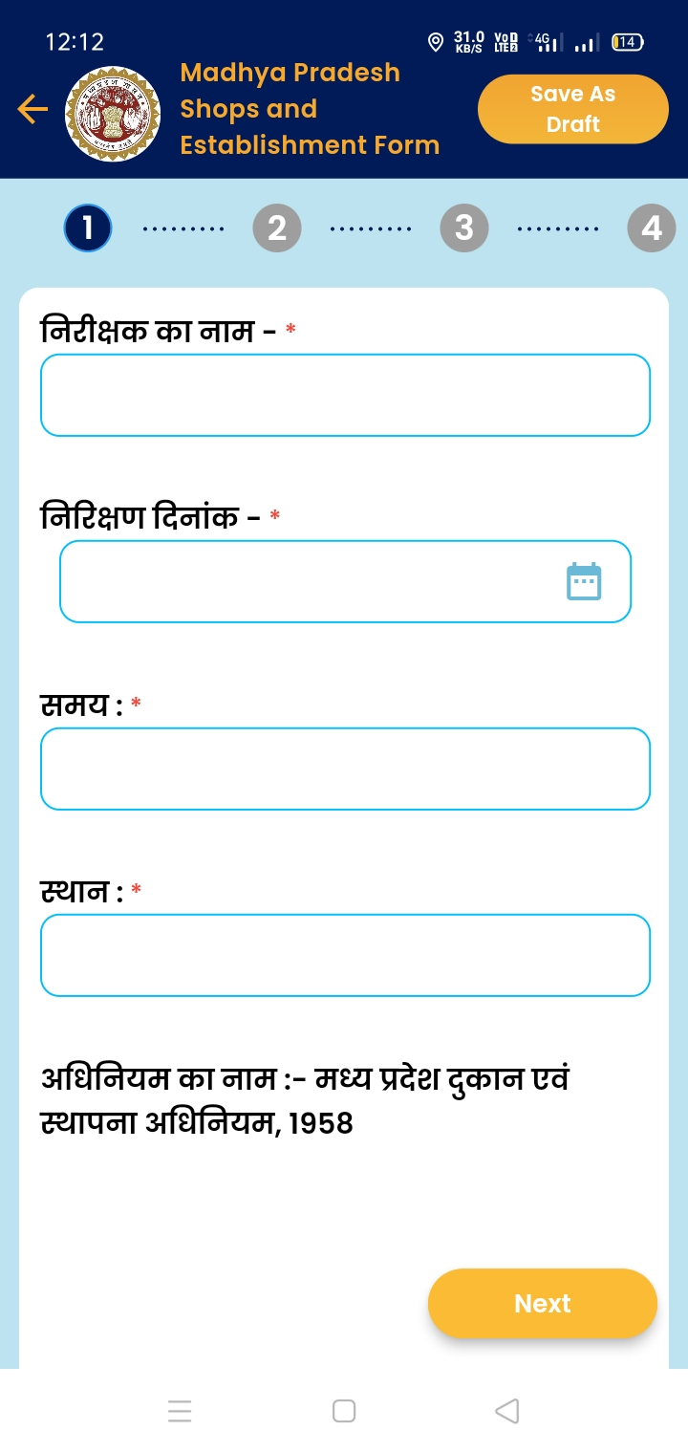
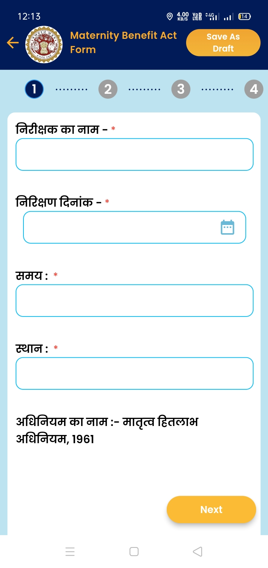
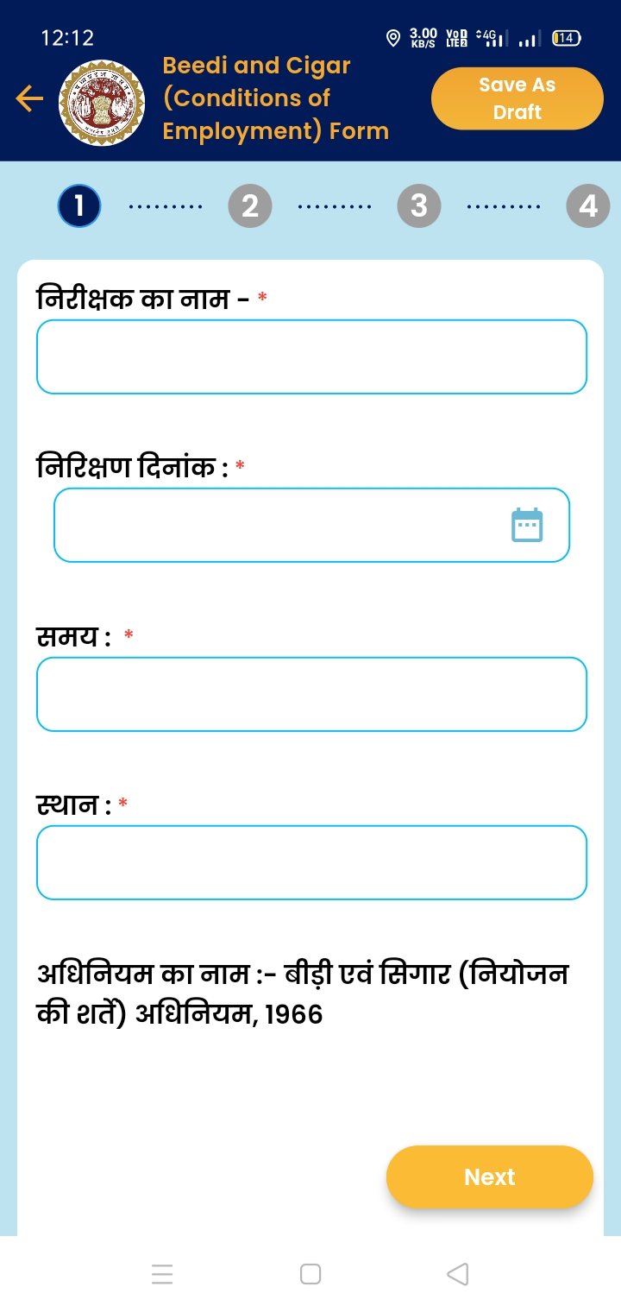
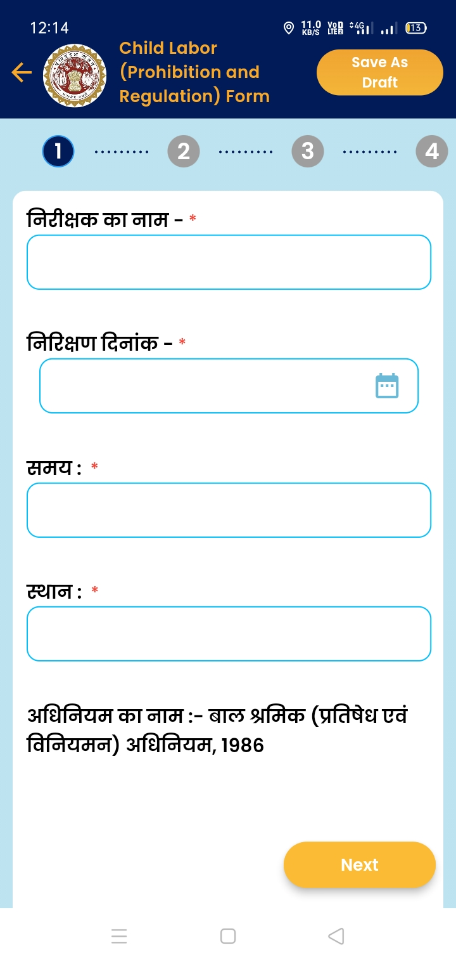
Mobile View of Inspection Forms (To fill the form while inspecting at site)
Site Inspection Form

Slide 9
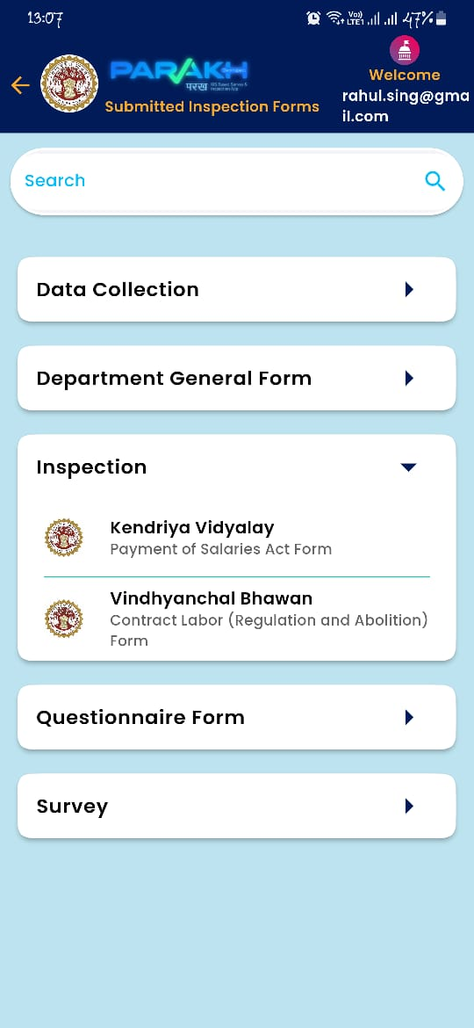
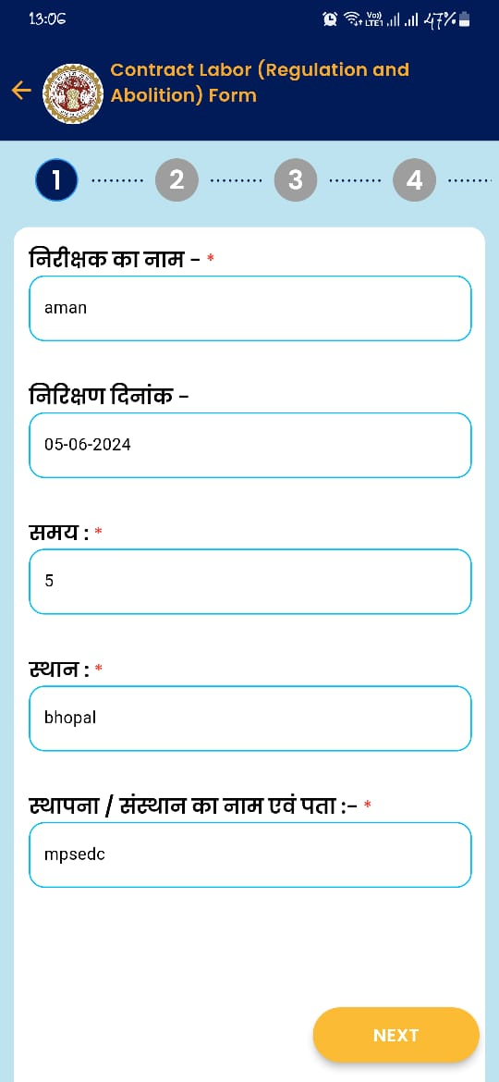
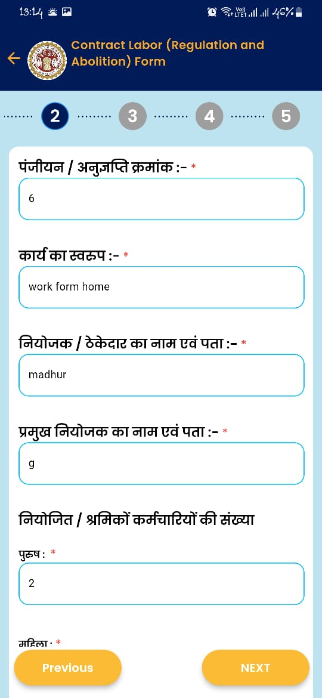
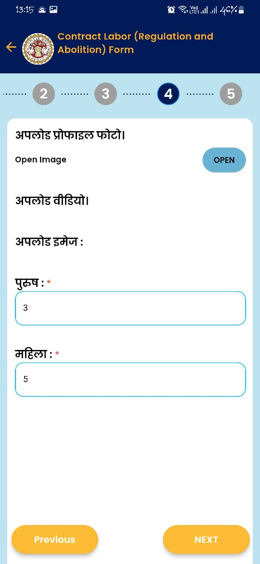
Mobile View of Inspection Submitted Form
List of Inspections Conducted
Details of Site Inspection Conducted
Details of Site Inspection Conducted
Details of Site Inspection Conducted

Slide 10

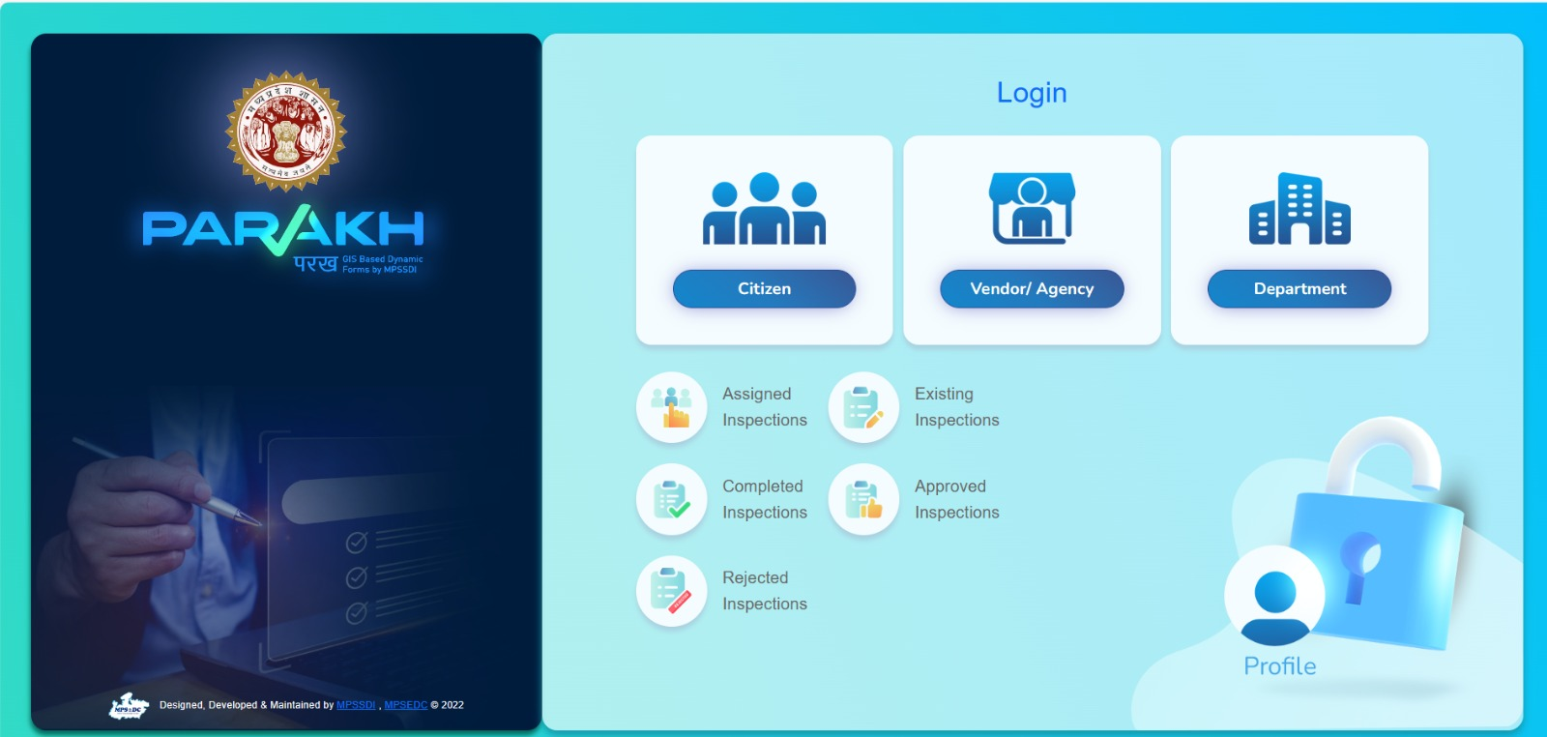
Web View of Labour Department Inspection Portal
Web Login Page

Slide 11
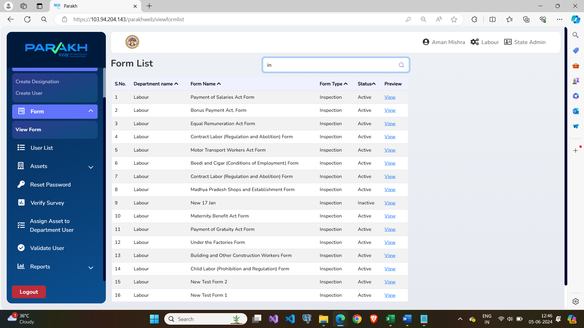
Web View of Portal Usage
Department State Admin View: List of all the available inspection forms

Slide 12
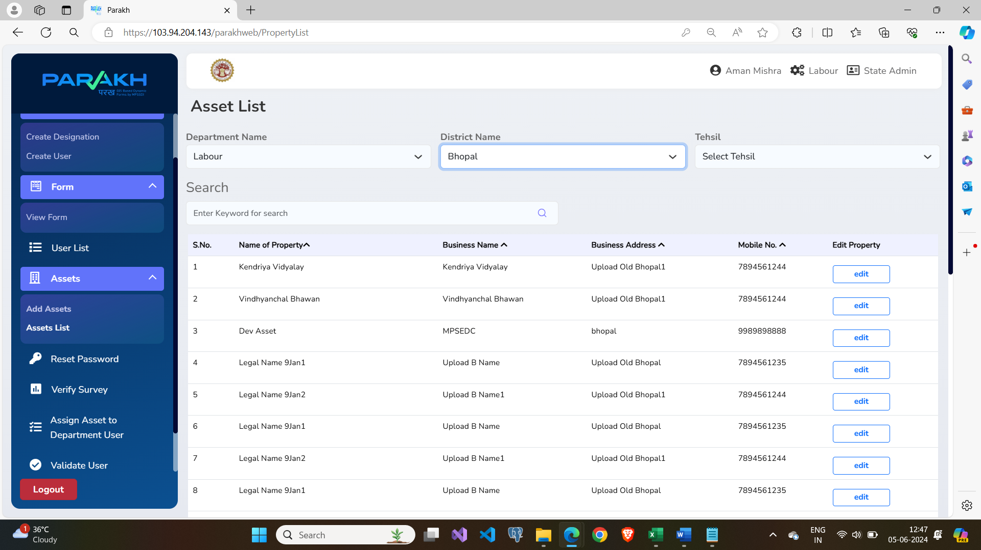
Web View of Portal Usage
List of all the sites/assets to conduct Inspection

Slide 13
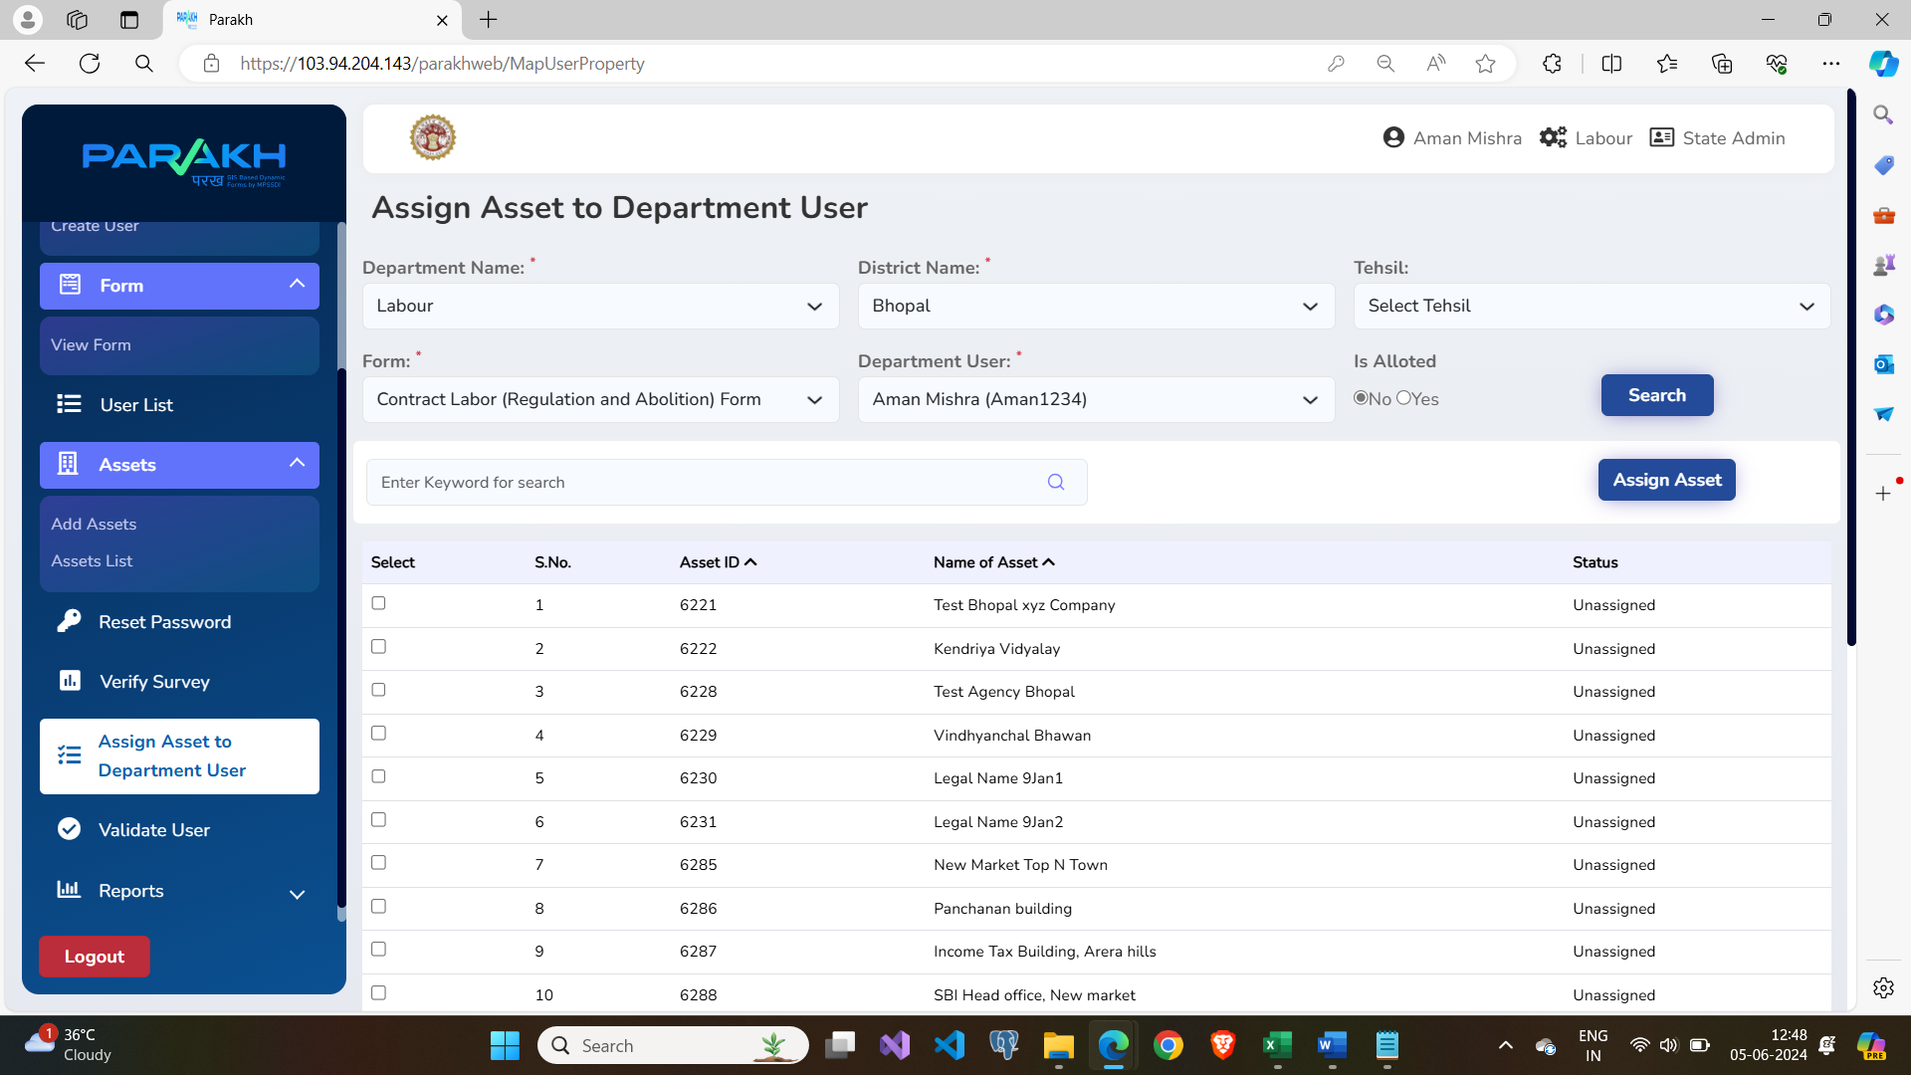
Web View of Portal Usage
Assign sites/assets to the Field Officer to conduct the Inspection

Slide 14
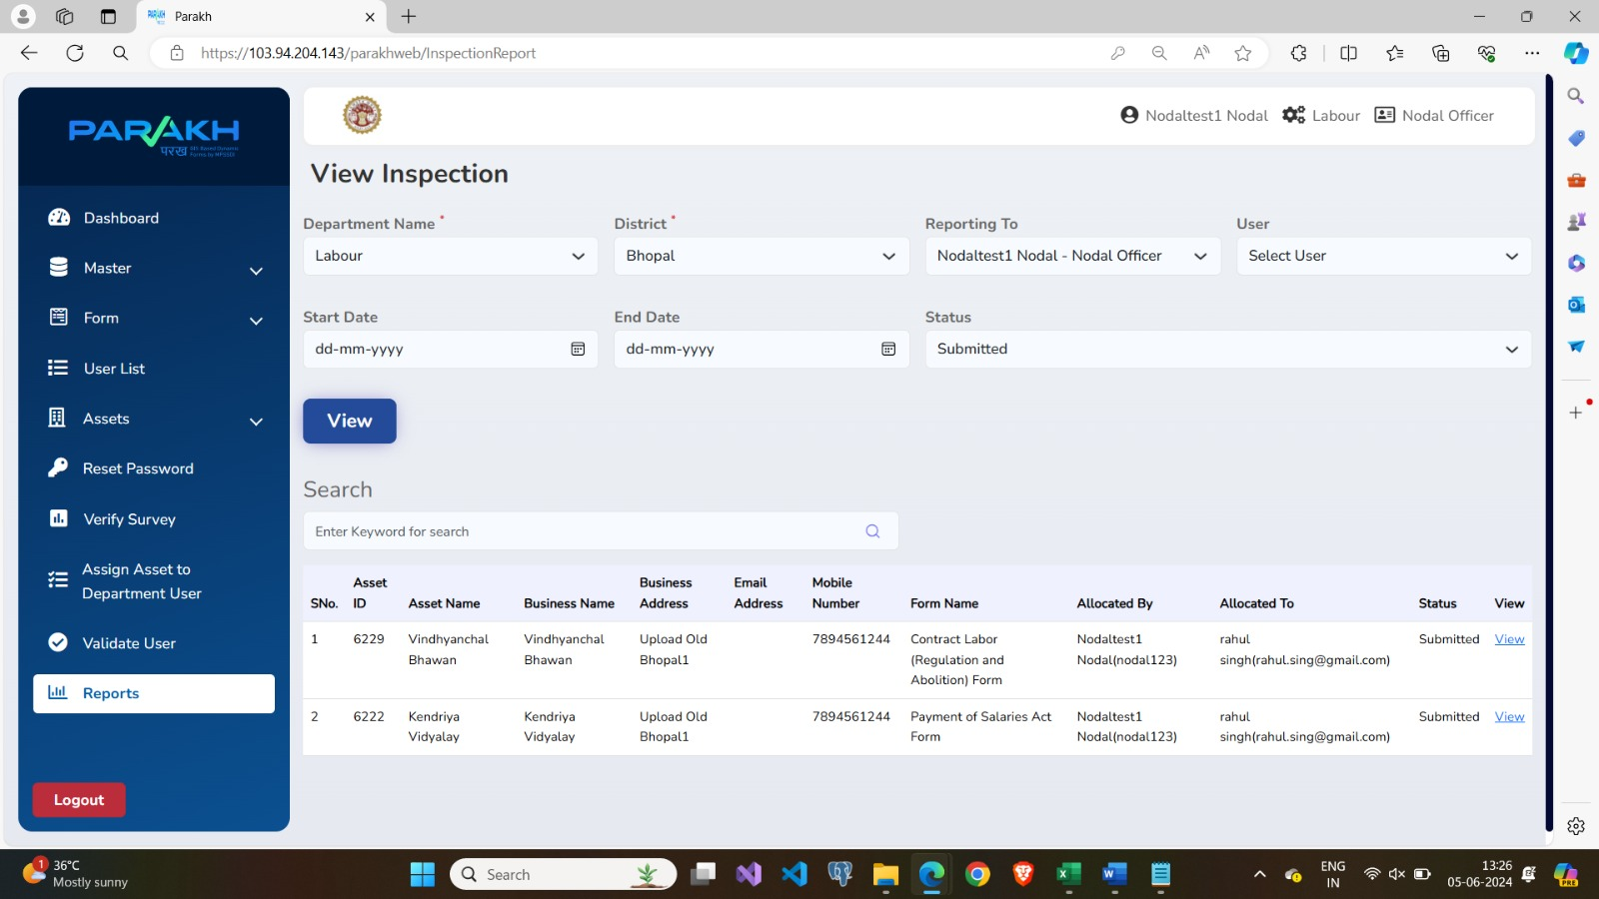
Web View of Portal Usage
View of Inspection data that is filled by the Field Officer

Slide 15
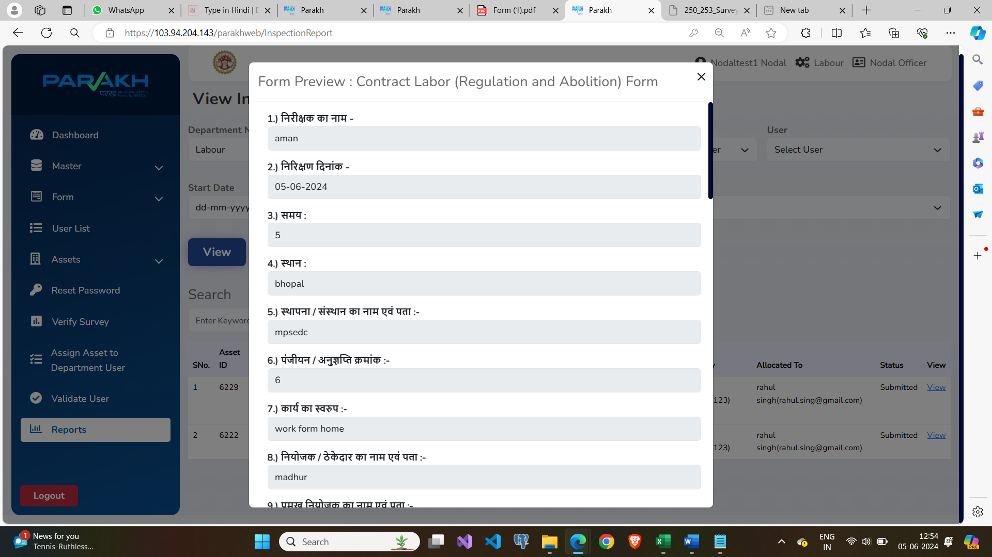
Web View of Portal Usage
Nodal officer view the “Inspection Data” that is filled by the Field Officer

Slide 16






Citizen Workflow (General Purpose Custom Forms)
Citizens can utilize the Parakh application to login and fill out the request forms like “New Borewell Request” and other various types of forms, created by the different departments.
Citizen
Citizens will login independently using mobile, based on OTP authentication.
After Login Citizens will be able to access and view all the "General Purpose Forms" created by various departments.
Citizens will fill out the respective GIS-based forms like “New Borewell Request” etc.
Once the citizen submits the request form, it will be displayed for action by the respective departments and agencies.

Slide 17
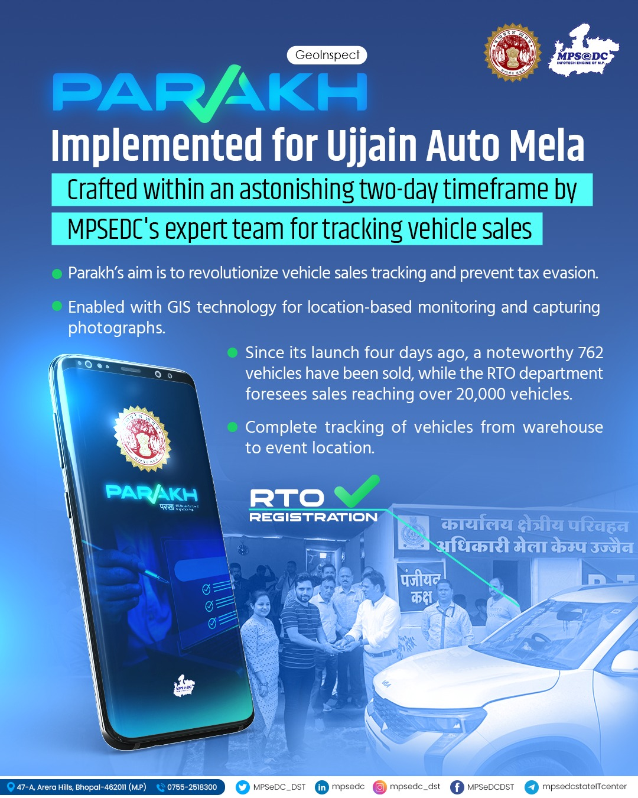
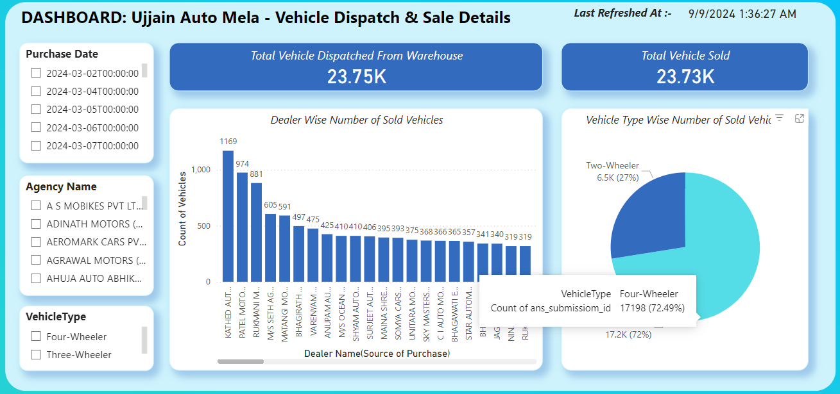
Ujjain Vikarm Auto Mela
Vehicle Dispatch & Sale Entry
Parakh's Mobile Application was designed and launched for the M.P. Transport Department in an impressive timeframe of just two days.
The app features two GEO-tagged and GEO-fenced dynamic forms:
Dispatch Entry: To record vehicle dispatches from the warehouse.
Sale Details: To capture details of the vehicle and purchaser during sales.

Slide 18
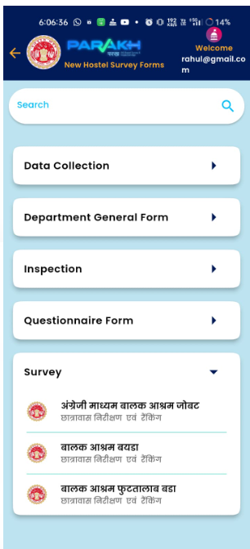





Hostel Inspection & Rating Application
Alirajpur Collectorate, Madhya Pradesh
Features & Usage
Parakh’s Geo-Tagged & Geo-Fenced features equip the Alirajpur Collectorate, Madhya Pradesh to organize Inspection & Rating of Hostels across the Alirajpur District in MP.
Parakh Inspection forms are enabled with a workflow:
Parakh Web Portal is facilitated for the State Admin and Nodal Officer to:
Visualize location-wise inspections and their MIS reports.
View a GIS map view of the inspected Hostels.
Nodal Officer assign work to field officer via web portal
The Field Officer sees the assigned work with all the information of the site under PARAKH application.
Field officer input and capture GIS-based Inspection/Survey details through the mobile application.
Following the submission of the Inspection/Survey by the field officer, the nodal officer undertakes a review and verifies the submitted data.

Slide 19

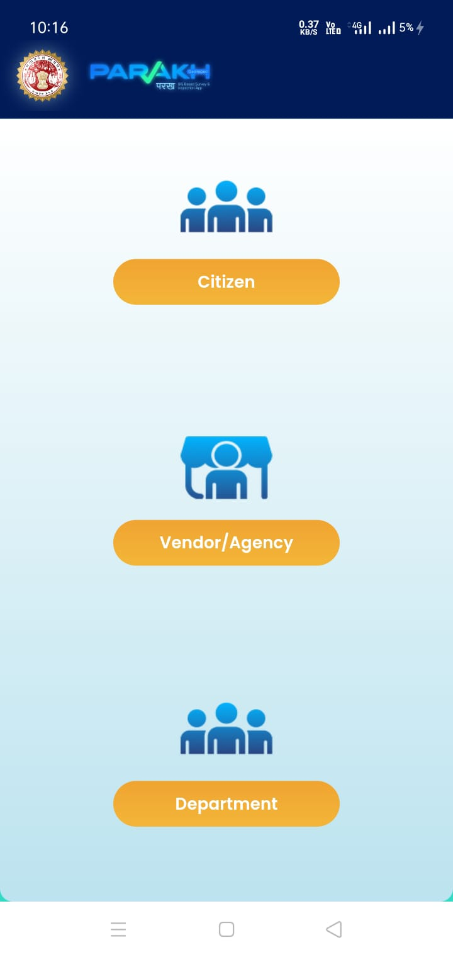
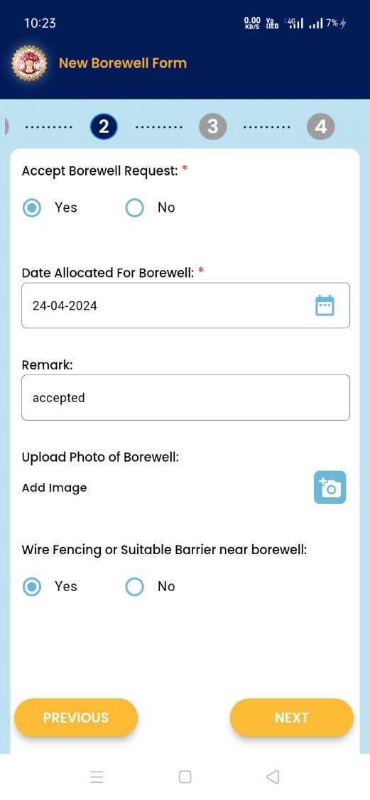
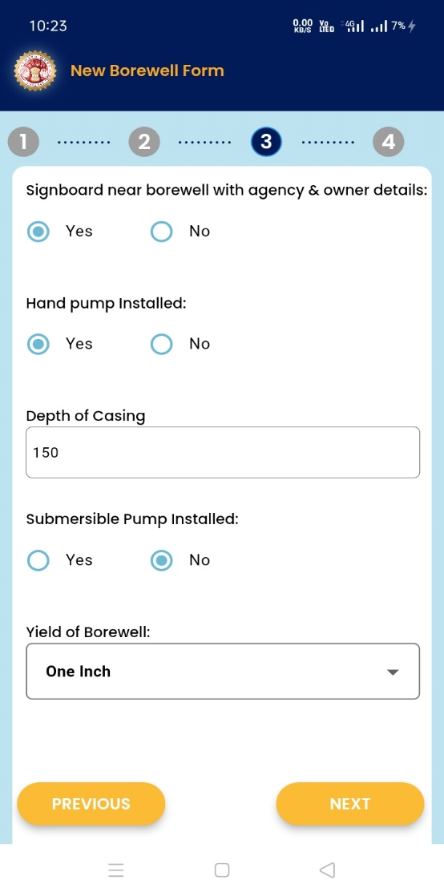


Borewell Management System
New Borewell Request & Notification
Parakh framework is customized for PHE department to manage New Borewell Request & its Compliance as per the instructions of Honorable Supreme Court
Incorporated Features
Registration of the Borewell Agencies, which perform the borewell digging
Enablement of citizens to raise a request/notification for the New Borewell work to start.
Notifying the PHE Department, when the new borewell work starts.
Compliances of completion of Borewell work via geo-tagged images and videos,
Notification to the PHE department for the completion of Borewell work.
Agency’s acknowledgement for borewell work
Agency to fill the compliance report
Mobile Application
New Borewell
Web Portal
New Borewell
Citizens: Raise a request to initiate borewell work
Agencies: First acknowledge the borewell request, Followed by filling the compliance report, on work completion.
Department: Monitors & view compliance reports
eServicesRegistration: Agencies register themselves for Borewell Work

Slide 20

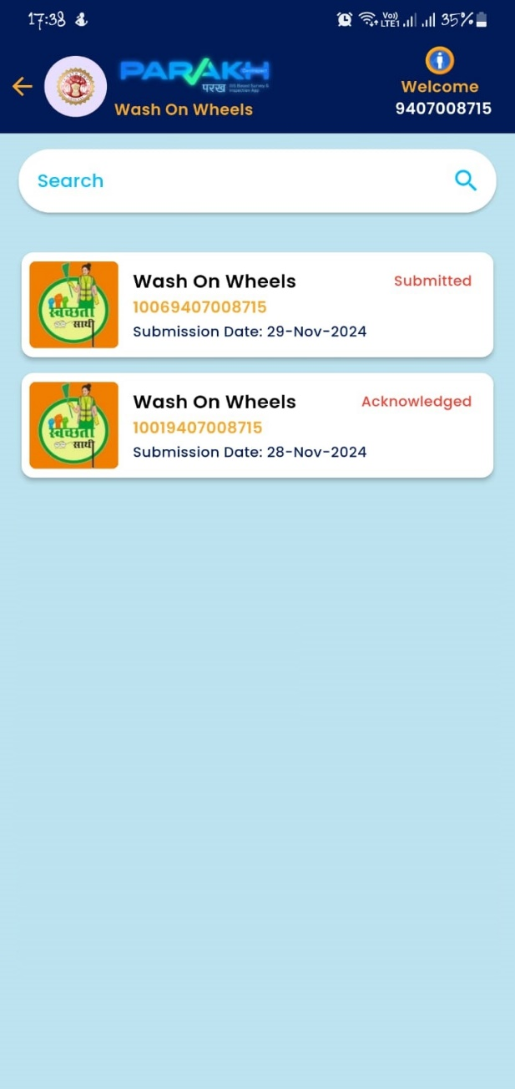
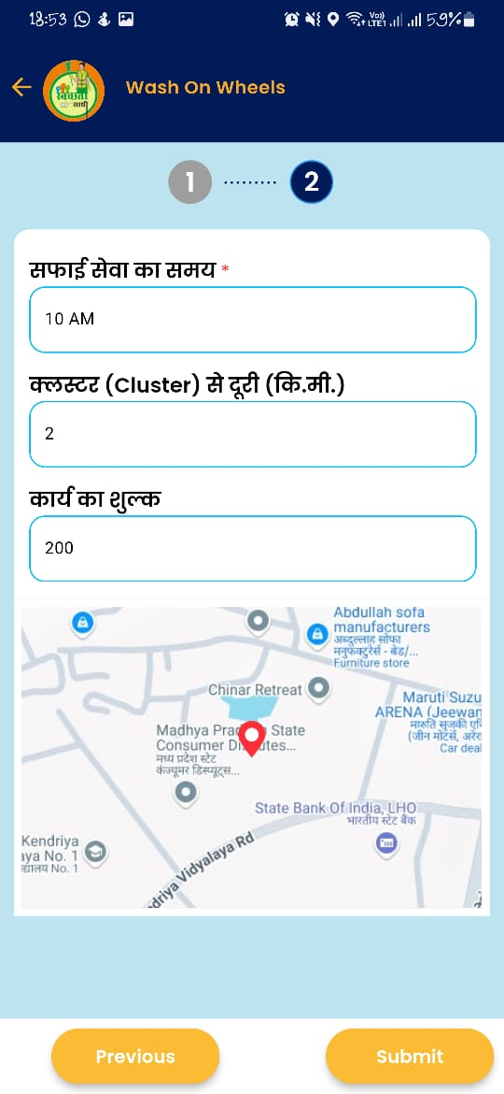
Wash on Wheel Application
Chhindwada Collectorate, MP
Features & Usage
Parakh’s framework having Geo-Tagged & Geo-Fenced features is used to build solution for Wash on Wheel Application for Chhindwada district.
Wash on Wheel application enables
The citizen or asset in-charge for Anganwadi, School, Sulabh Shochalay, Panchayat, Hospitals, Hostels etc can fill a cleaning request. The cleaning request is raised from the cleaning site along with a captured photo, GEO location via the Mobile App.
Allocation of the cleaning work to the available “Swachata Sathi” for cleaning is done by the cluster incharge via the WEB Panel.
The allocated cleaning work, is visible to the cleaning vehicle/Swachata Sathi on their Mobile App., they will perform the cleaning work and fill the compliance form and submit. The task will be considered completed/closed, and the vehicle will be available for next service.

Slide 21

Wash on Wheel Workflow
Request for cleaning is raised by Asset In-charge via Mobile Application.
Officer at Cluster/District Level sees the cleaning request. Officer assigns the cleaning work to the available vehicle.
Notification is received to the Field Vehicle for the assigned cleaning work.
Cleaning Vehicle visualize the cleaning request and can also see the GIS map view of the path.
Conducts the cleaning work and submits the form along with the GEO tagged photo in the mobile application
Officer at Cluster/District Level sees the cleaning work completed.
As Department (Web Portal)
Login as Citizen
Mobile App
Login as Department (Web Portal)
Actors of the Application
Login as Agency/Vendor (Mobile App)

Slide 22
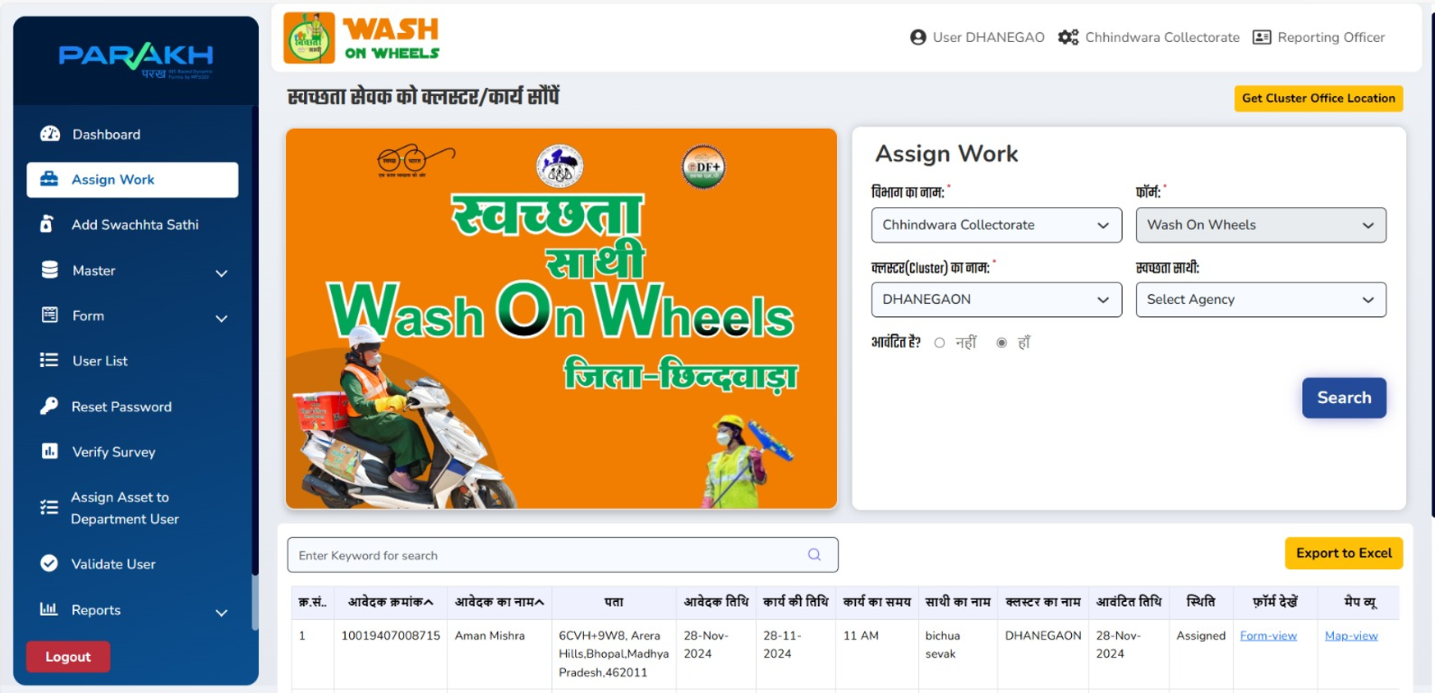
Web Panel for the allocation of Cleaning Site
Cluster Admin/Supervisor will assign the sites/assets to the Vehicle-Incharge to conduct the cleaning

Slide 23


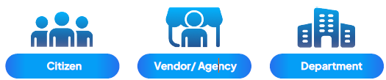


Dynamic Forms
Survey, Inspection and General Purposes
On-The-Fly Launch GIS Enabled Mobile Application using Dynamic Forms
Ease of Use: Department’s admin Or business user can create their own custom forms. No dependencies on code/development/build. Usage could be for Survey, Inspection, Data Collection, Questionnaire or General Purpose.
Workflow: Survey and Inspection forms are equipped with a workflow. The Admin can “initiate & assign” a survey, inspection, or initiate a general form.
Reach: Enables “Citizens” and “Age ncies” to fill out the forms.
Solution: Versatile solution designed for both Mobile and Web.
Quick to Launch: Create a form using UI interface(web) and launch it on Mobile.
Few Implementations:
Ujjain Auto Mela - Vehicle Dispatch & Sale, Ujjain Commissioner
Hostel and Instant Site Inspection App for Alirajpur Collector
Wash On Wheel for Chhindwara Collectorate
Site Inspection Form for Bhopal Commissioner Office
Borewell Management System for PHED
14 Inspection forms for Labour Department

Slide 24
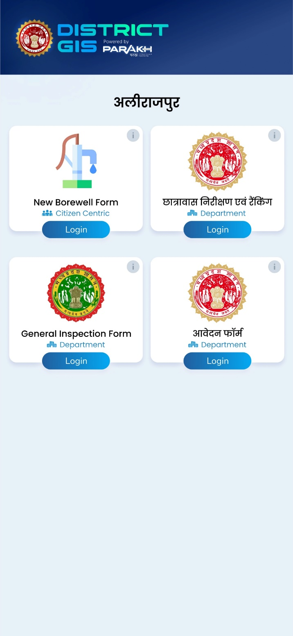
DistrictGIS Application for District Governance and Management
DistrictGIS mobile & web application powered by Parakh framework aims to facilitates the following capabilities:
Monitoring and Governance of Projects, Schemes by District Administration
Each District Admin shall be able to create their own GIS enabled Survey, Inspection, DataCollection & General Purpose Forms dynamically using the Web Panel.
The District Admin shall be able to launch their self made, various kind of forms and launch on the DistrictGIS Mobile Application instantaneously.
DistrictGIS mobile app is build with GIS tools and customized Dashboards for District Collectors to monitor physical progress of projects and schemes, run campaigns and monitor Panchayat/Tahsil level performance
Dynamic forms are enabled with workflow.
Admin Web Portal is facilitated for District Admin and Nodal Officer to:
Visualize GIS map view surveys, inspections and other submitted forms and MIS reports. Access PowerBI dashboard

Slide 25



Reach Out to
MPSEDC Ltd. State IT Centre, 47-A, Arera Hills, Bhopal-462011 (M.P.)
Thank You
CONTACT
+91 755 2518300, +91 755 2518500
mpssdi@mp.gov.in

